Slide 1

Energy Transfer through the ecosystem

Slide 2
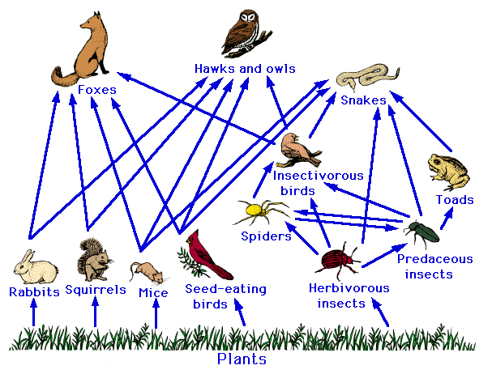
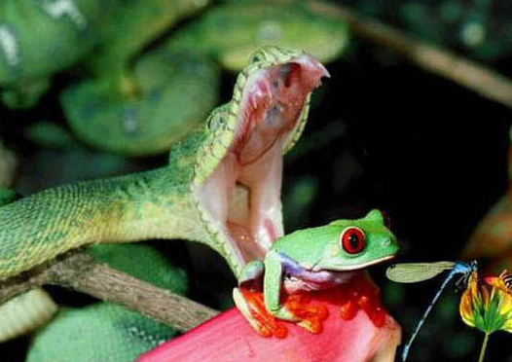
Food Chains and Webs
We prefer food webs as it shows all the food chains in a particular ecosystem and how they interact.

Slide 3

Using this food web
Identify a:
Producer
Primary Consumer
An organism that occupies more than 1 trophic level
Which group of organisms are missing from this food web?

Slide 4
Energy transfer
Lesson objectives
By the end of this lesson pupils should be able to….
Describe how energy is transferred though ecosystems;
Outline how energy transfers between trophic levels can be measured;
Discuss the efficiency of energy transfers between trophic levels;

Slide 5
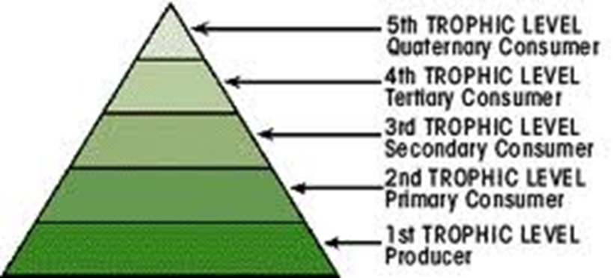
Organising Food Chain Pyramids
They are always arranged in this order with producers at the base
and the top carnivore at the top

Slide 6
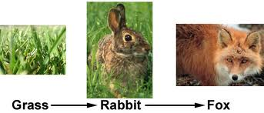

Displaying Food Chain Data
Pyramid of number

Slide 7
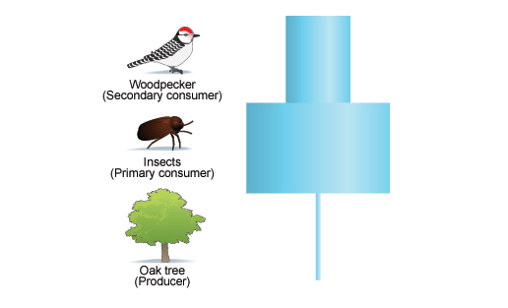
When Pyramids of number go wrong!
Sketch the pyramid of number you would expect for this food chain
Seeds birds cat fleas

Slide 8
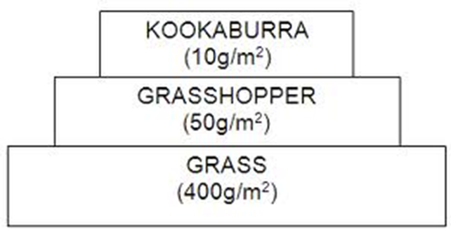
Pyramids of Biomass
One solution is to use biomass data instead of numbers
Units are often in Kg/m².
How is dry biomass data
collected?

Slide 9
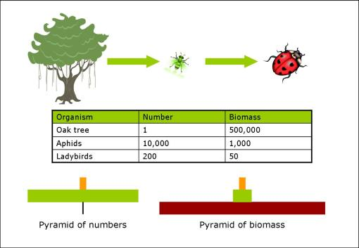
What are the limitations to using pyramids of biomass?
This now looks like a pyramid, as the tree’s size is taken into account.
Work through the exam question ED2

Slide 10
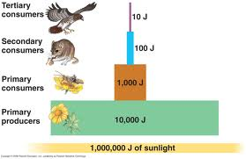
Pyramids of Energy
Burn the organism at each trophic level in a Bomb Calorimeter to find the energy content in J /g of dry biomass
Limitations
Snap shot of an ecosystem at a given time without reflecting any seasonal variations.
May provide a distorted idea of efficiency of energy transfer due to variations in populations.

Slide 11
Pyramids of Energy Flow
These take into account the numbers and size of the organism.
They can be calculated for a given area and time span, e.g. KJ / m² /year.
Large Fish
126 KJ/m²/yr
Small Fish 2220KJ/m²/yr
Zooplankton
7980 KJ /m²/yr
Phytoplankton
31080 KJ /m²/yr

Slide 12
Energy and ecosystems
Matter is constantly re-cycled within an ecosystem e.g. nutrient cycles.
Energy is not – it flows through the ecosystem
Light energy
Biotic element
Heat energy
Abiotic element

Slide 13
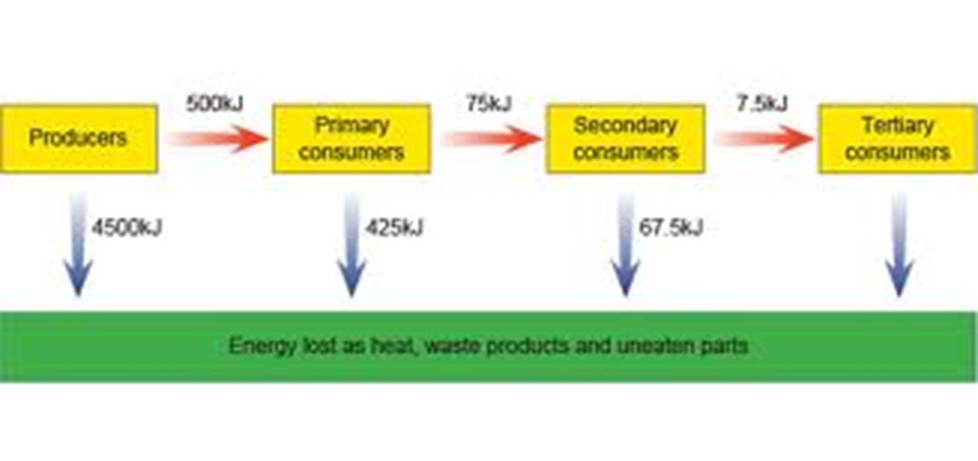
Energy Efficiency calculations?
Energy transferred to next level
X 100
Energy in the previous level
Efficiency of energy = transfer
Work out the efficiency of the energy transfer between each trophic level in the given food chain

Slide 14

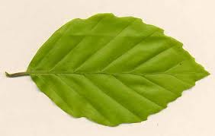

What proportion of the light that radiates on to plants is captured by photosynthesis?
In a study at Silver Springs in USA they measured this
7 120 000KJ/m²/yr
87 110 KJ/m²/yr
Fixed during photosynthesis
Efficiency
87110 $÷7120000 X 100$
= 1.2%
Why is this so poor?
Why does so little light energy get captured?

Slide 15
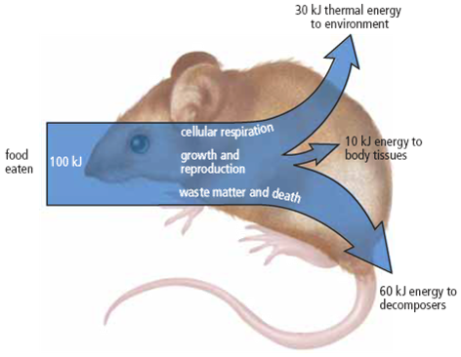
How is Energy Lost from the Ecosystem?
Not all the energy contained in a trophic level passes to the next level
For every 100KJ this mouse consumes
60KJ is wasted or lost in dead tissues
because the food is undigested, passes to decomposers in faeces, urine and dead tissues
Only 10KJ will be available for growth. It is this proportion that becomes new tissues and can be consumed by the next trophic level
30KJ converted into heat.
during respiration

Slide 16
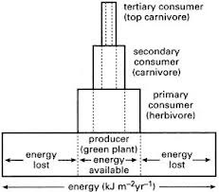
Energy transfer through the food chain

Slide 17
Differences in energy transfer between levels
The efficiency differs between different food chains and levels. It depends on
  How well materials can be digested
  Energy requirements e.g.
    surface area : volume ratio,
    environmental temperatures
    activity levels.eg plants do not expend much energy on movement compared to animals

Slide 18
Because of this there is energy has been lost from the ecosystem between each trophic level – limits the number of trophic levels in each food chain.
These pyramids of number illustrate the problem. The more trophic levels the greater the area required to input sufficient energy to supply all the consumers further up.

Slide 19
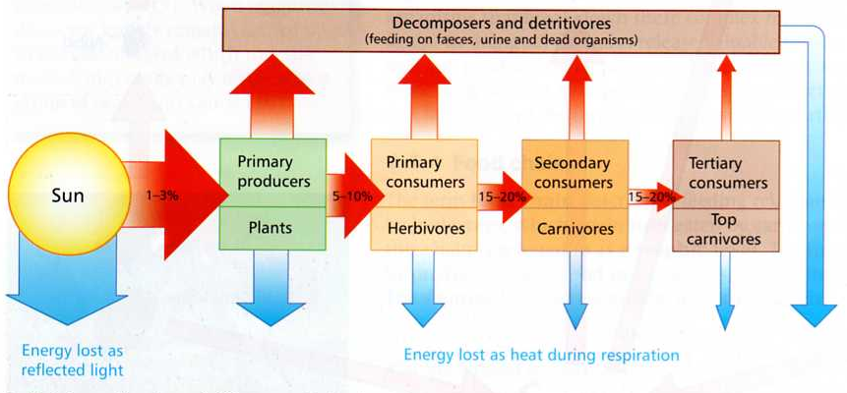
Energy losses in food chains
Exam question on energy transfer

Slide 20
Productivity
Productivity = the rate at which energy passes through each trophic level, per unit area (usually one square metre), in a given amount of time (usually a year)

Slide 21
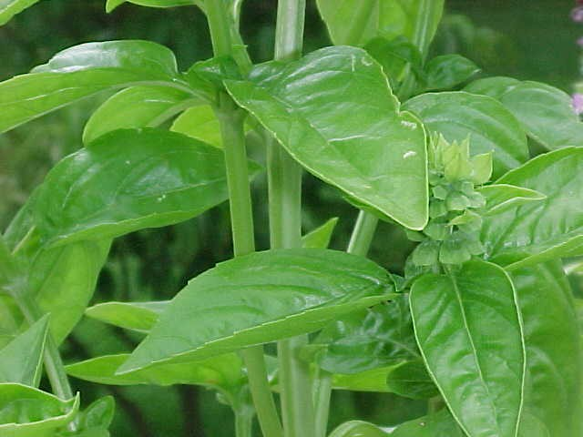
Primary productivity
Gross primary productivity (GPP):
Rate at which plants convert light energy into chemical energy
Net primary productivity: (NPP)
GPP - the energy lost through respiration.
This is the energy available to herbivores
How can we increase NPP so that crop yields are bigger ?

Slide 22
Secondary Productivity
This is the energy obtained by consumers.
Consumers are relatively inefficient at obtaining energy from producers but it is less efficient to eat animals than plants.
  (Some places plants cannot grow and humans rely on hunting animals e.g?)
Each animal wastes energy from indigestible materials, as not all parts of a plant or animal are eaten
  E.g.as cellulose, fur, bones, wood
  Secondary productivity can be improved in a number of ways

Slide 23
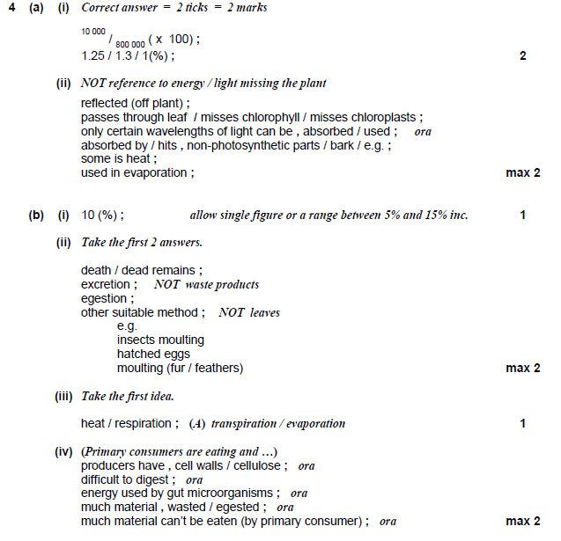

Slide 25
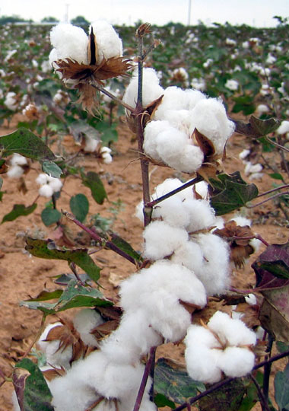
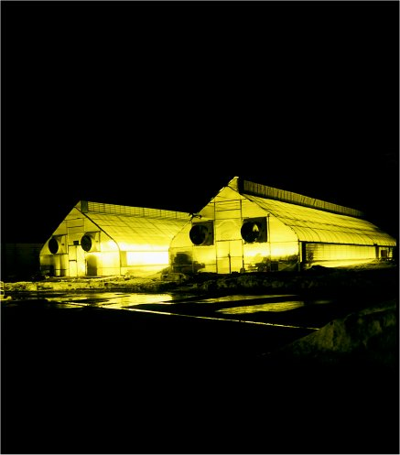
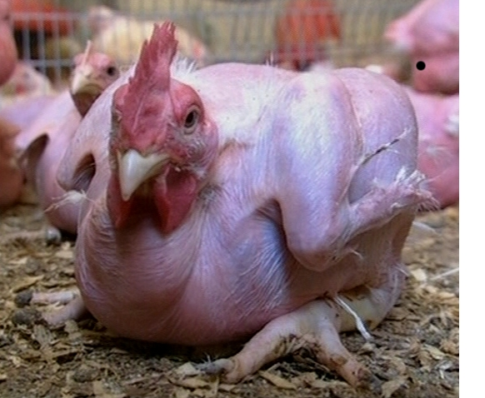
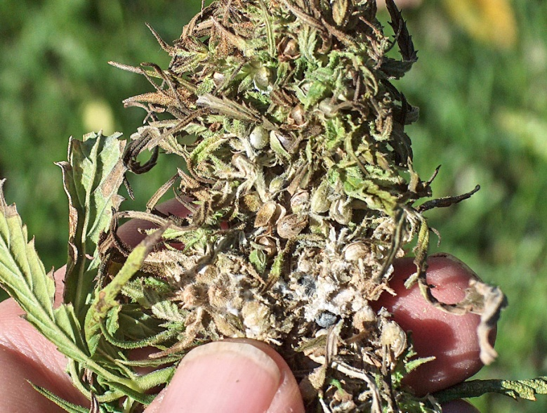
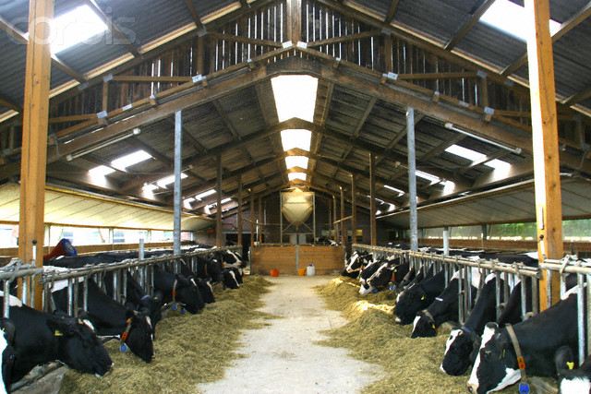
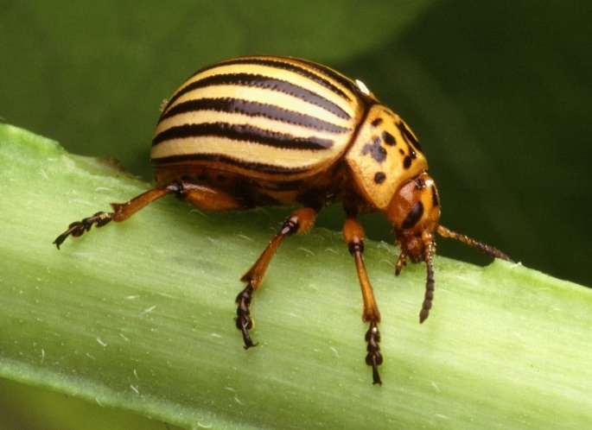
How could we manipulate energy transfer for our benefit?
The Meatrix

Slide 26
Improving Productivity
Primary Productivity in Plants
Secondary Productivity in Animals

Slide 27
Improving Productivity
Primary Productivity in Plants
Secondary Productivity in Animals
Increase warmth and light intensity in greenhouse crops
Early planting gives longer growing seasons
Irrigation/ drought resistance
Fertilisers/ crop rotation/N₂ Fixing crops to increase growth
Pesticides
Fungicides
Herbicides
GM crops/selective breeding e.g wheat crops

Slide 28
Improving Productivity
Primary Productivity in Plants
Secondary Productivity in Animals
Increase warmth and light intensity in greenhouse crops
Early planting gives longer growing seasons
Irrigation/ drought resistance
Fertilisers/ crop rotation/N₂ Fixing crops to increase growth
Pesticides
Fungicides
Herbicides
GM crops/selective breeding e.g wheat crops
Eating animals before maturity
Selective breeding e.g. in milk production
Use of antibiotics to reduce energy lost on fighting disease
Confine animals to reduce energy used to move around
Keep warm to reduce energy expended on keeping warm

